Slide 1
Recipe Suggestion based on similar ingredient tokens
H-R May Merkle-Tan, PhD
hengrumay@gmail.cm
Notes:
NOTES *
Would be good to have another app to put in a subset of ingredients and come up with some recipe suggestions.
OR to clarify – business case
I didn’t go into too much discussion about the usage… || similar to the weather project where I didn’t really discuss the work as much e.g. weather etc.
INTERESTINGLY – I could have dimension-reduced by SVD/NMF* and e.g. removed words that talked about ‘’HOW’’ the ingredients are used .?? MAYBE
***POINTING – try to use the mouse/laser pointer instead of finger pointed– blocking details. || APP demo (NOT LIVE)
SHINY app – Coursera??
Last Page Contact info / Blog etc.
Play up KEY WORDS for potential employers
POINTS TO CONVEY – ASPECTS OF PROJ that open up new insights etc.
FIRST FEW opening lines***

Slide 2
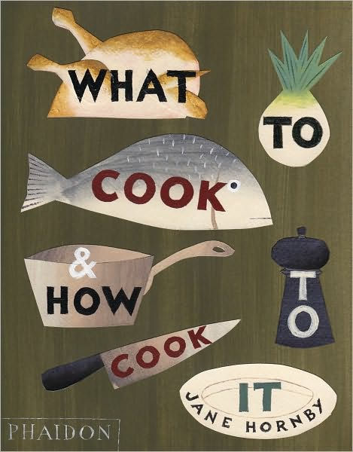
Pantry
Preferences
Allergies
Craving
Curiosity…
Creativity…
Recipes ???

Slide 3

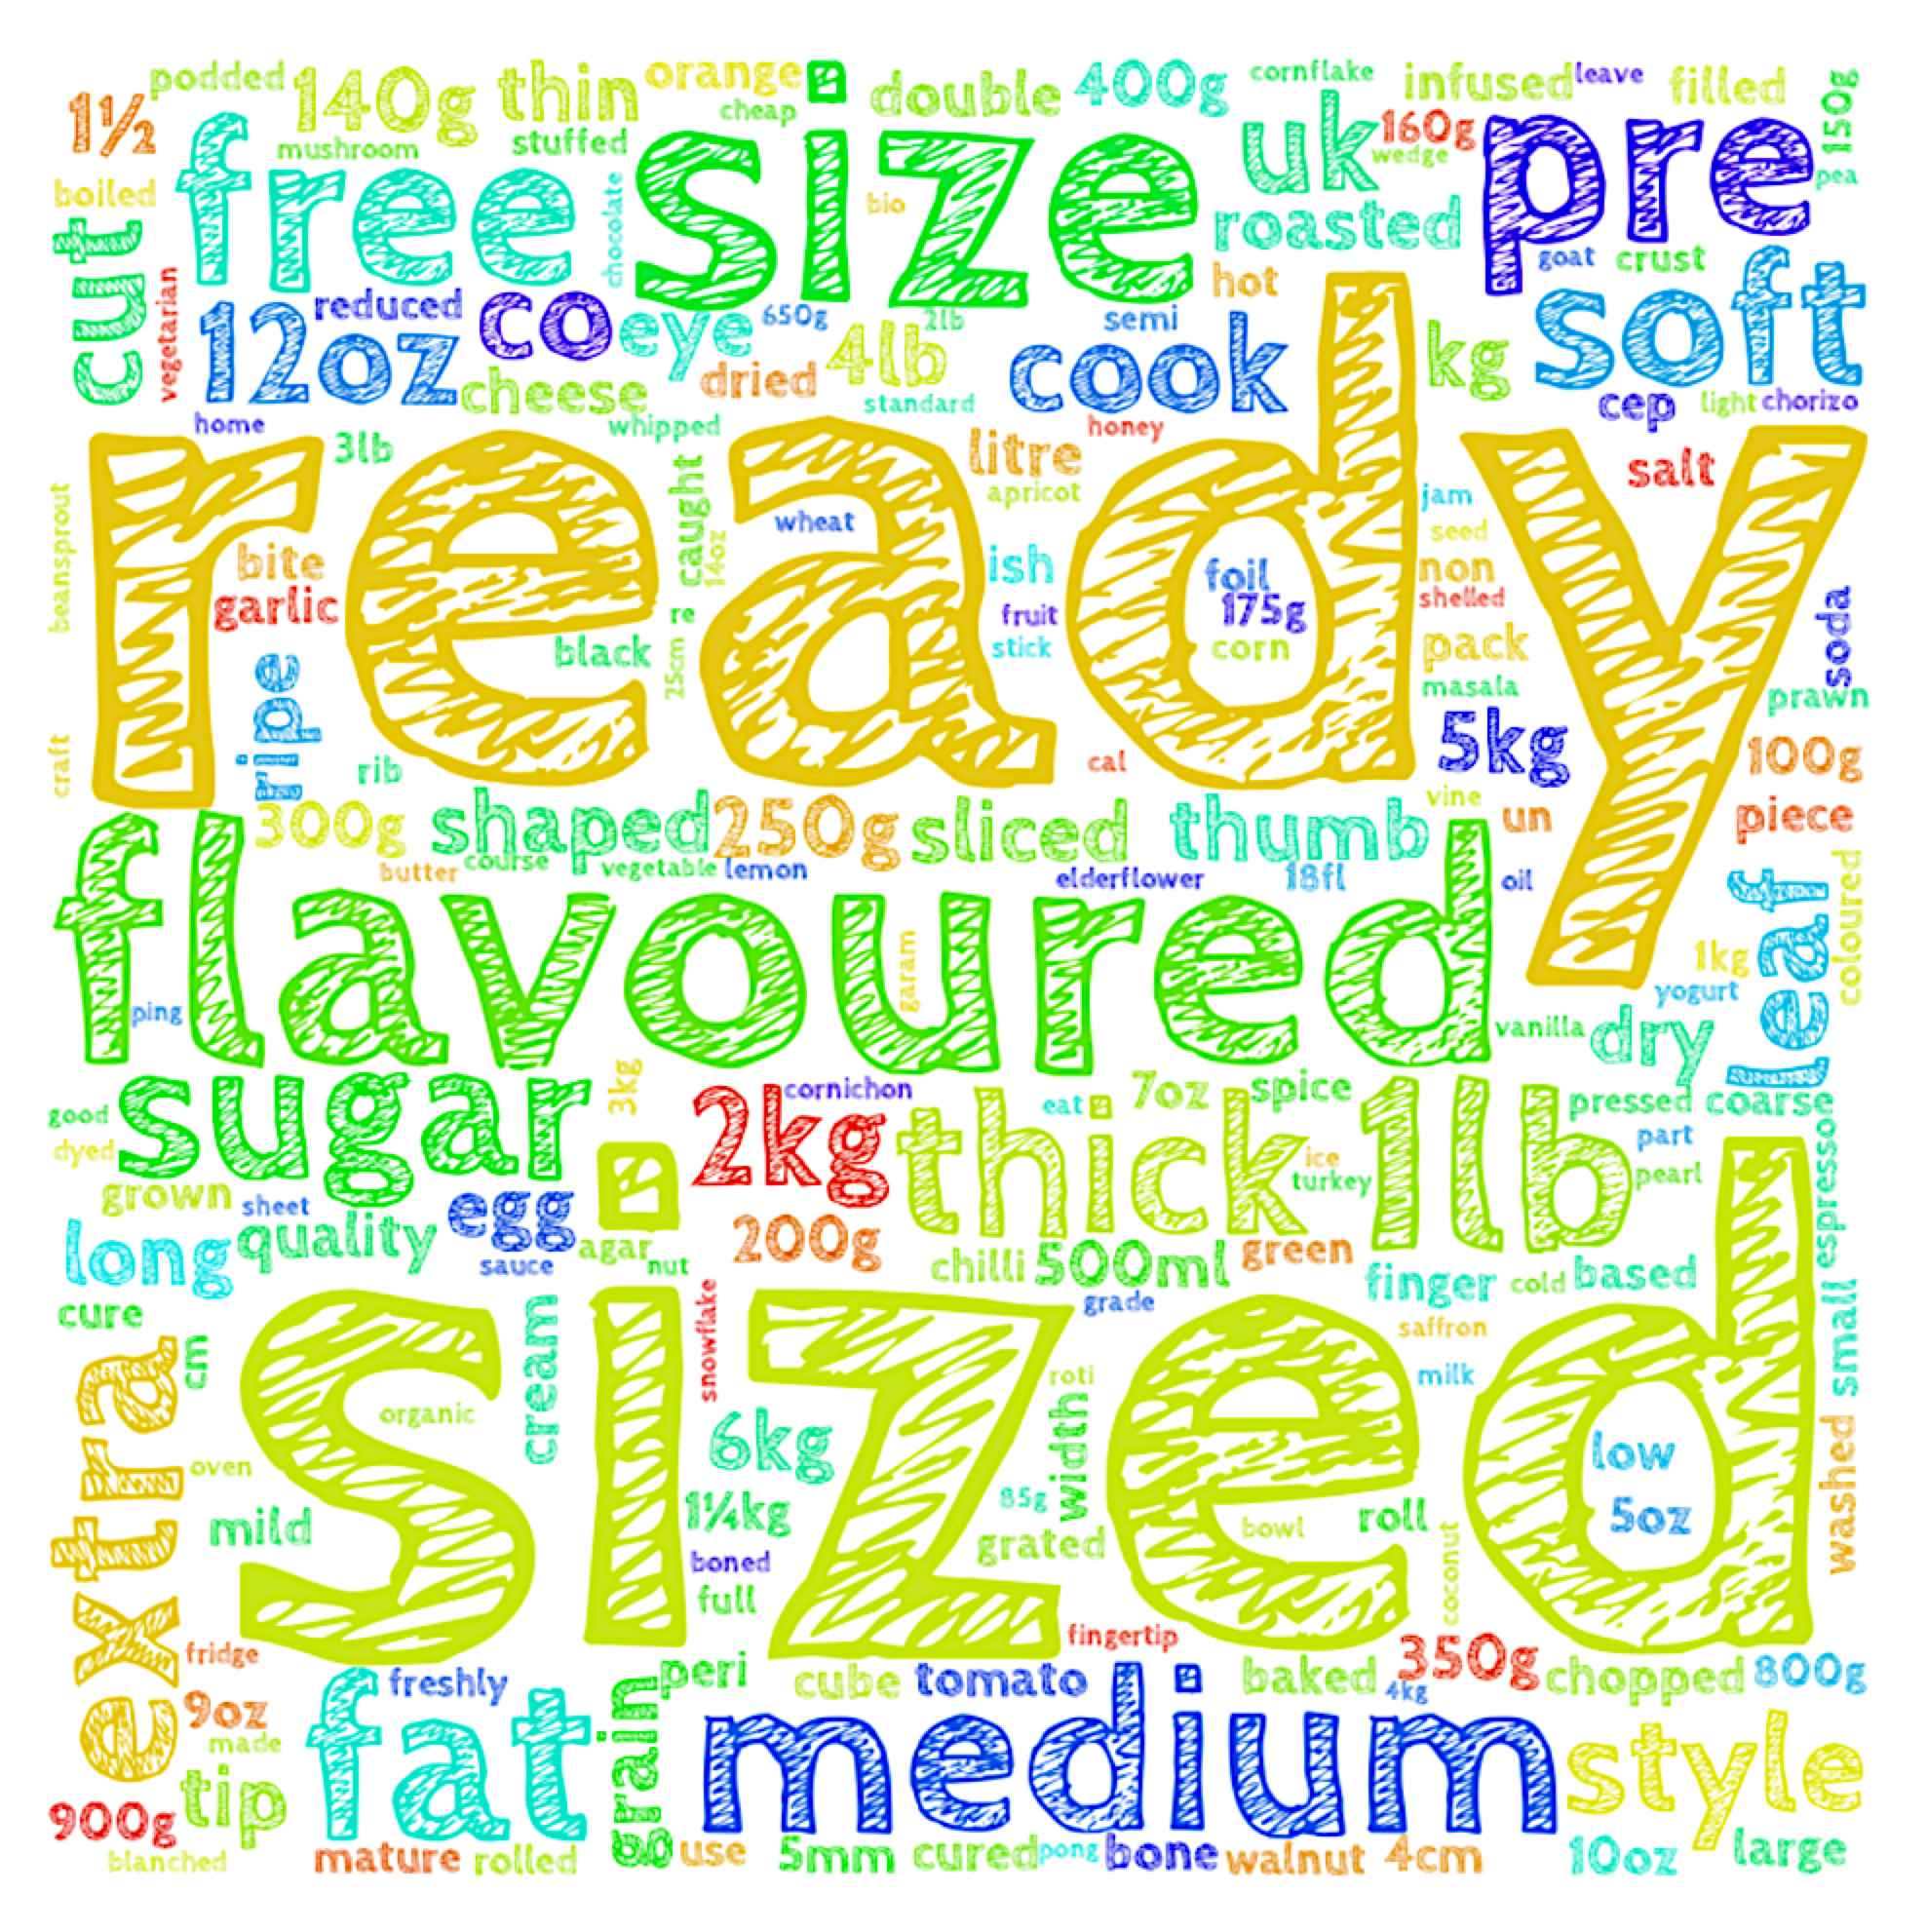
An overview:
~10,080 recipes: http://www.bbcgoodfood.com/
Curating a list of ‘ingredient’ words… *
POS -TAGs | Tokenizing | Lemmatizing |
word2vec – context of words*
INGREDIENTS
INGREDIENTS + Recipe TITLEs

Slide 4
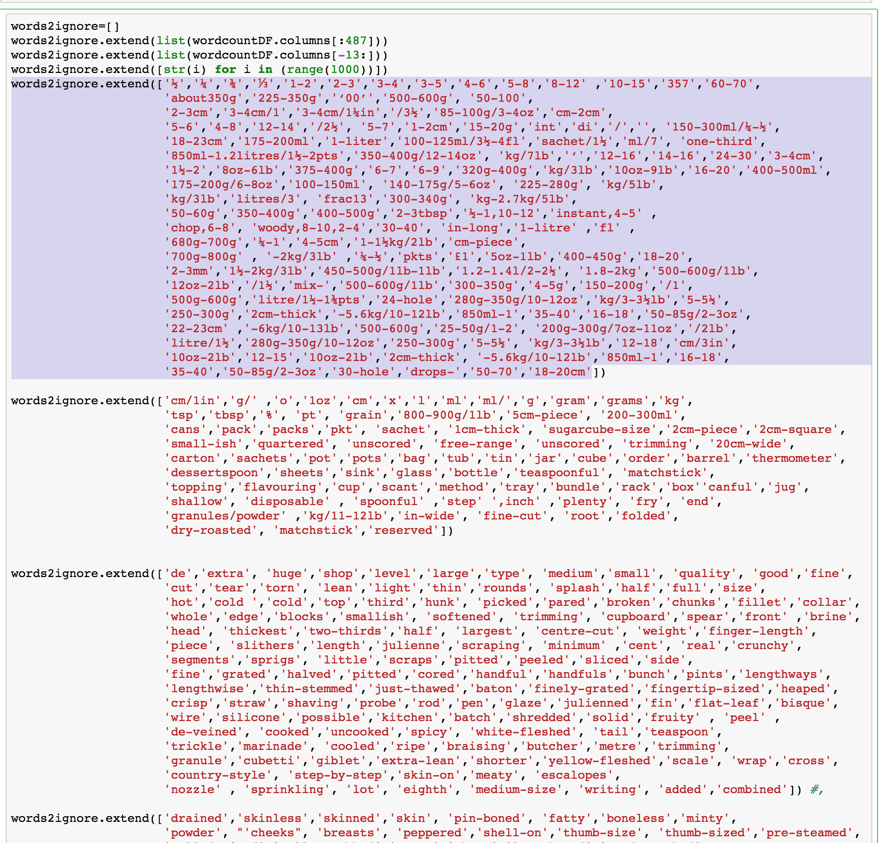

Slide 5
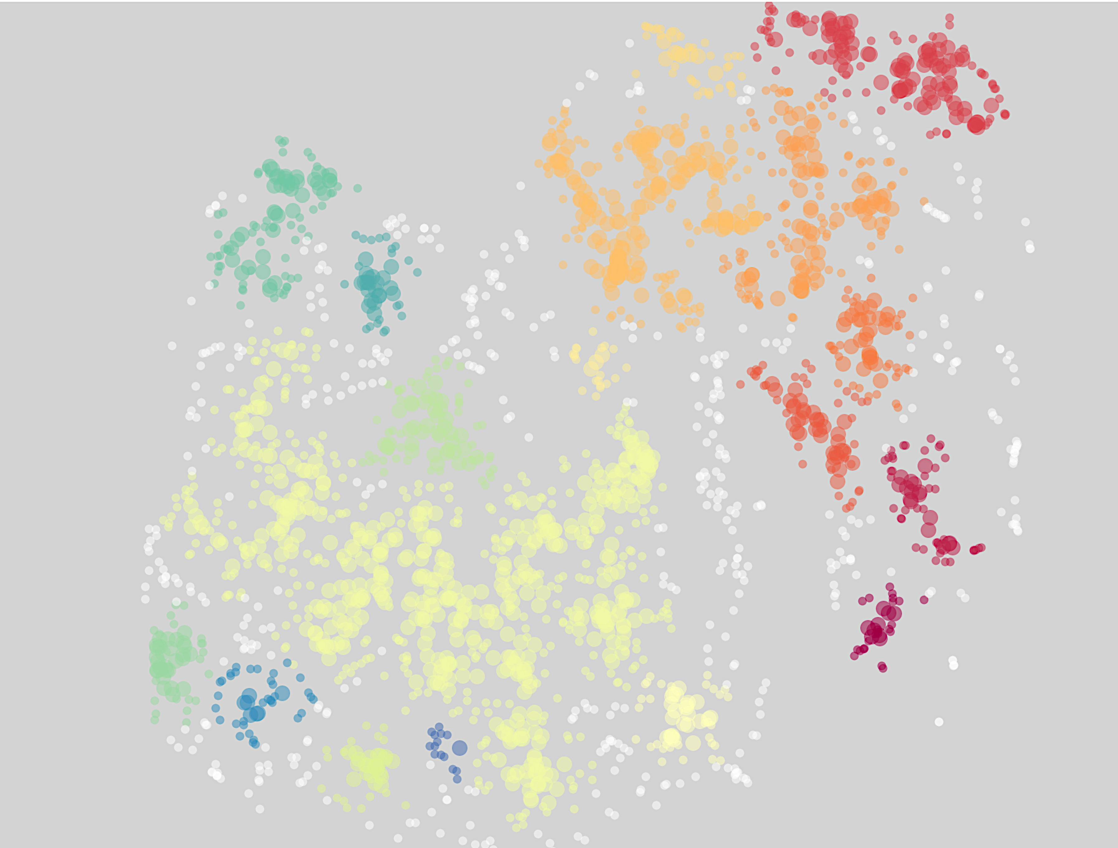
Items in INGREDIENTS:
w2vINGR.most_similar(positive=['rice'], topn=10)
[('basmati', 0.954),
('noodle', 0.884),
('risotto', 0.874),
('long-grain', 0.844),
('paella', 0.83),
('beansprouts', 0.819),
('vermicelli', 0.813),
('sushi', 0.811),
('tamarind', 0.81),
('dahl', 0.804)]
w2vINGR.most_similar(positive=[’ flour'], topn=10)
[('self-raising', 0.94),
('yeast', 0.936),
('polenta', 0.911),
('suet', 0.878),
('egg', 0.872),
('semolina', 0.872),
('soda', 0.865),
('cross', 0.862),
('bicarbonate-soda', 0.86),
('cornmeal', 0.854)]
Notes:
Estimated 18 clusters by Dbscan on T-SNE – but it doesn’t make much sense….

Slide 6
Items in INGREDIENTS:
w2vINGR.most_similar(positive=[’chilli'], topn=10)
[('flake', 0.916),
('coriander', 0.901),
('harissa', 0.87),
('paprika', 0.863),
('chipotle', 0.859),
("bird's-eye", 0.858),
('mild-to-medium', 0.851),
('adobo', 0.849),
('lemongrass', 0.845),
('fingertip-length', 0.844)]
w2vINGR.most_similar(positive=[’ strawberry'], topn=10)
[('raspberry', 0.988),
('jam', 0.978),
('punnet', 0.978),
('blueberry', 0.974),
('blackberry', 0.971),
('passion', 0.97),
('fruit', 0.961),
('mascarpone', 0.959),
('pectin', 0.959),
('curd', 0.957)]
w2vINGR.n_similarity(
['orange'],['lemon']) : ​0.835

Slide 7
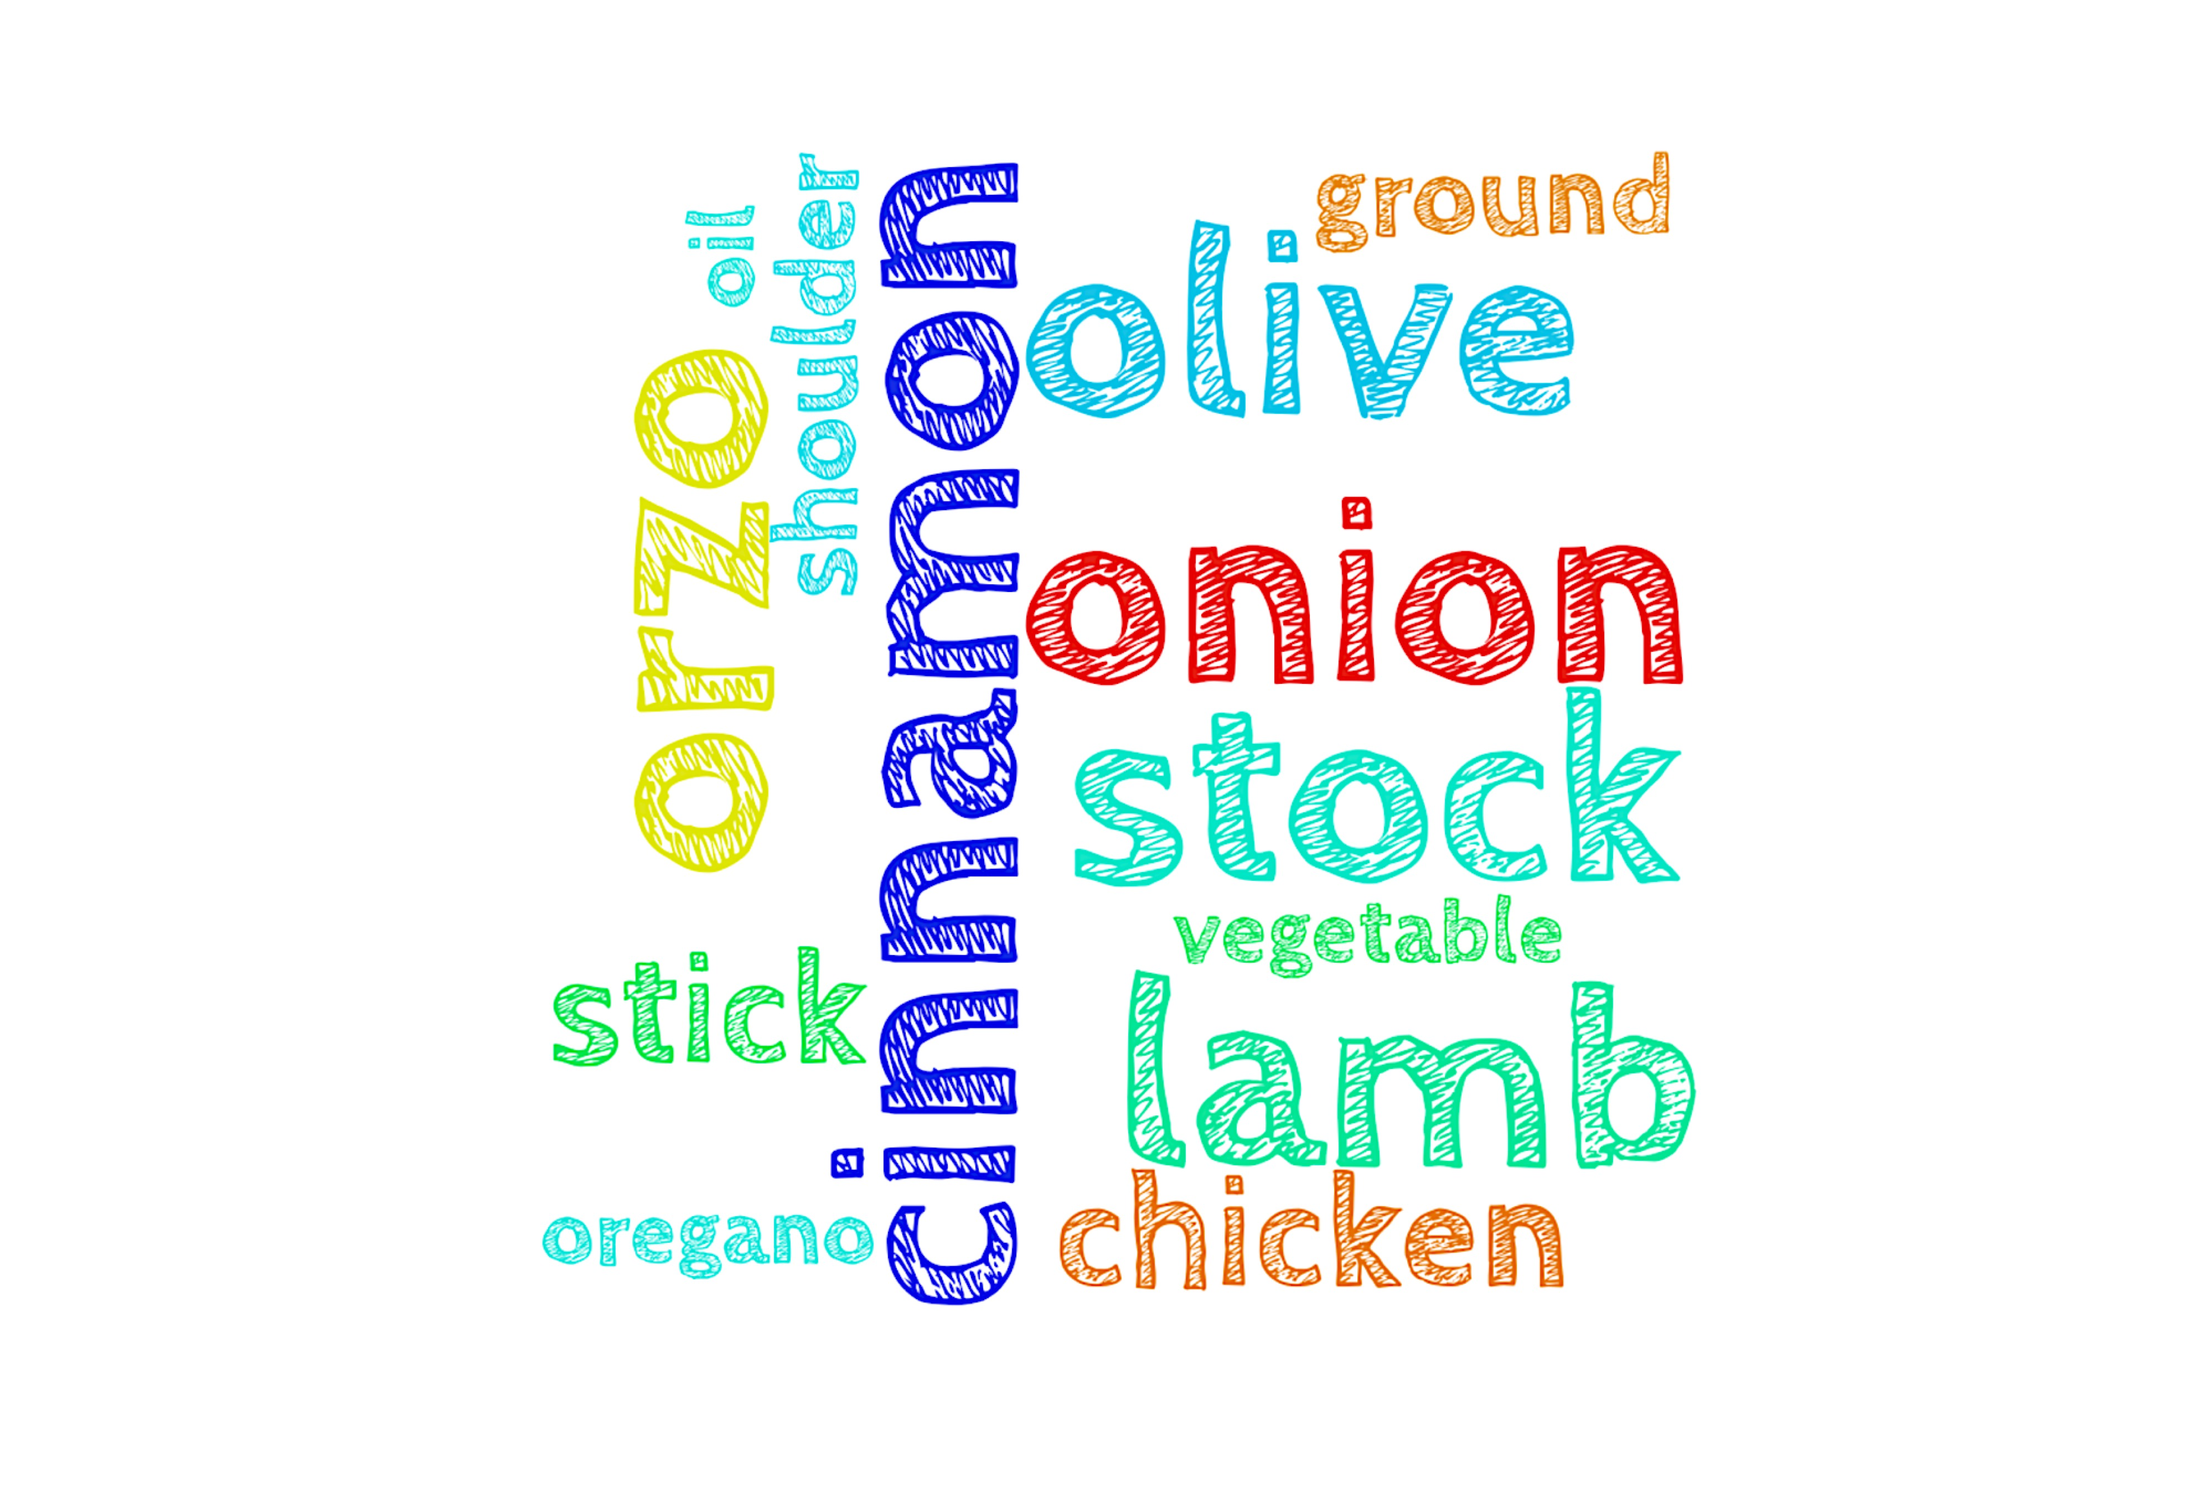
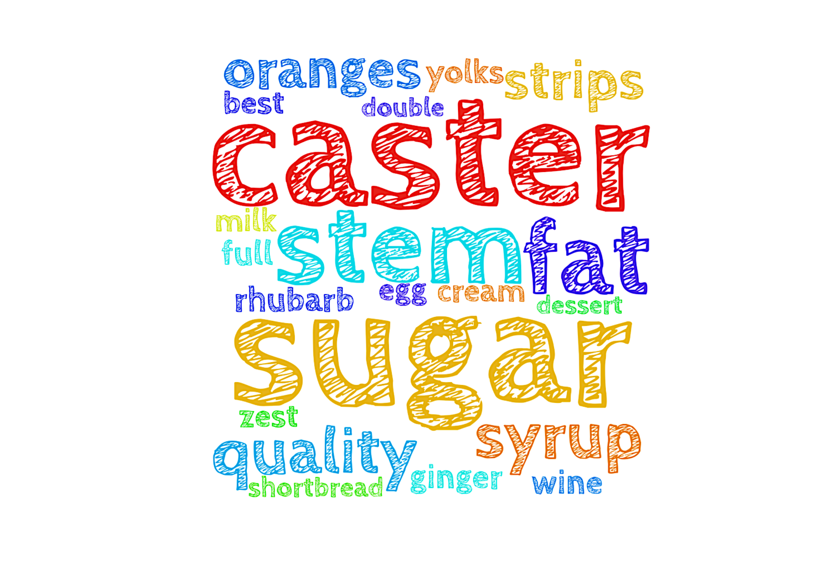
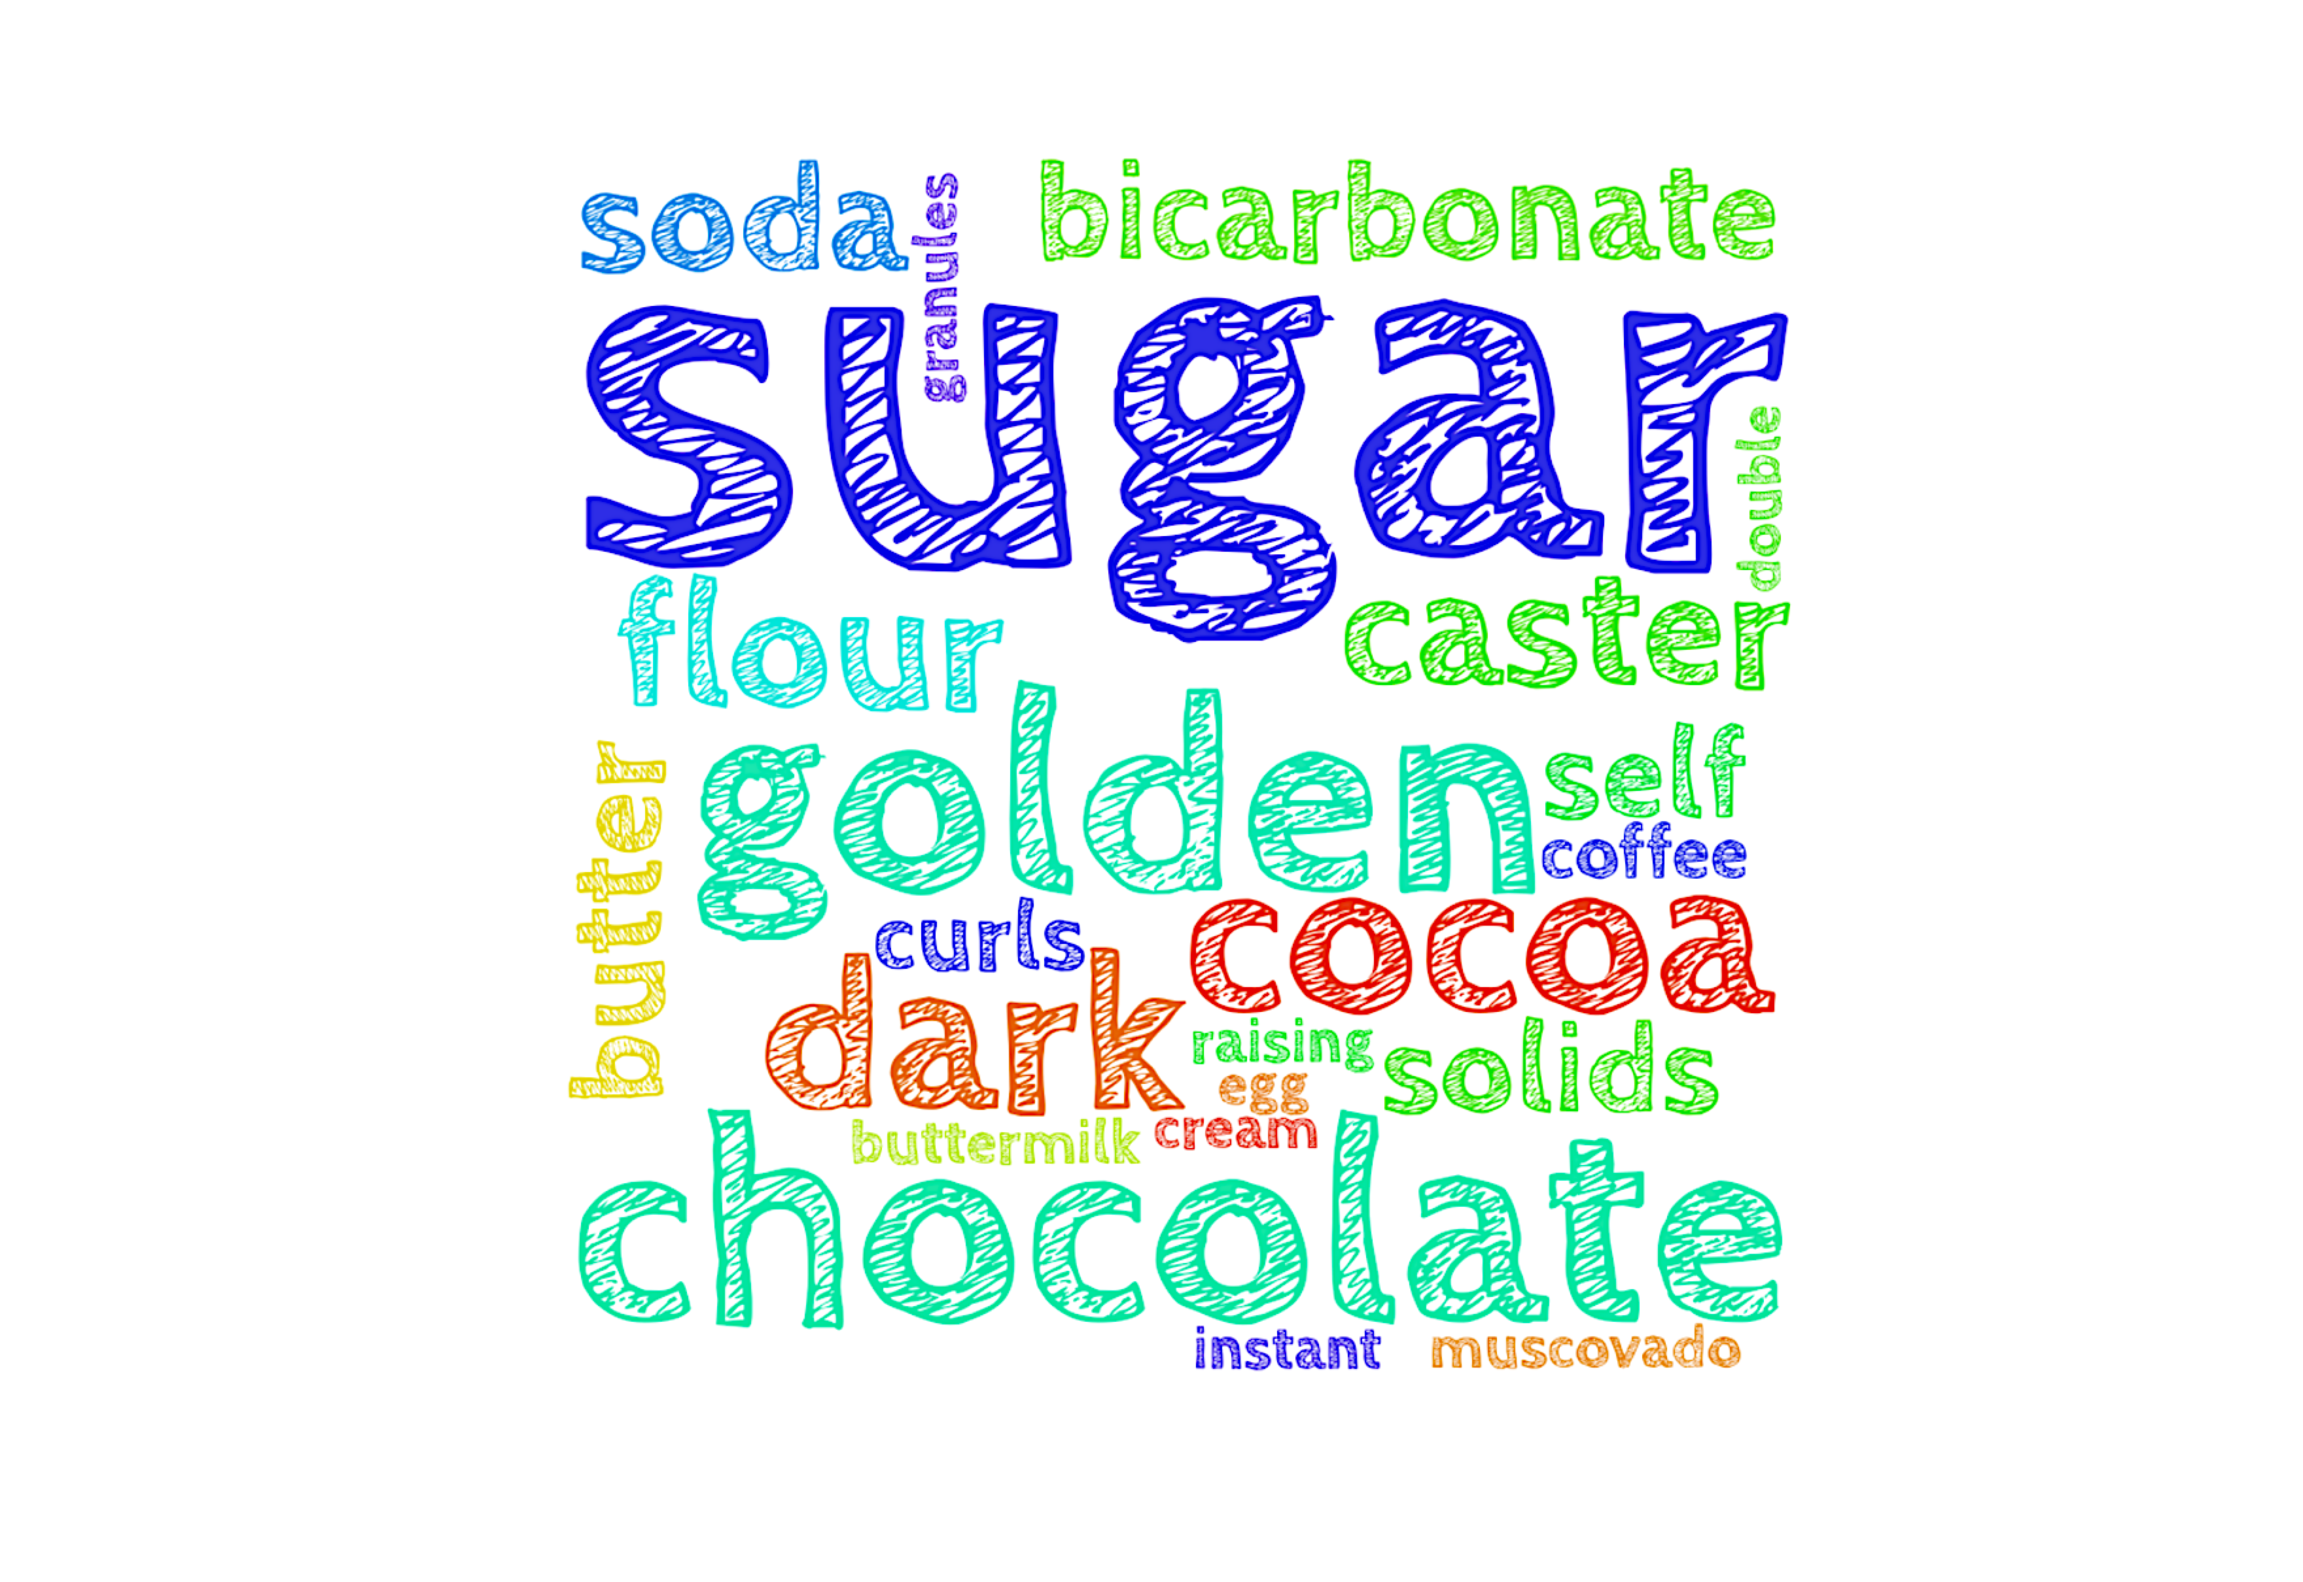

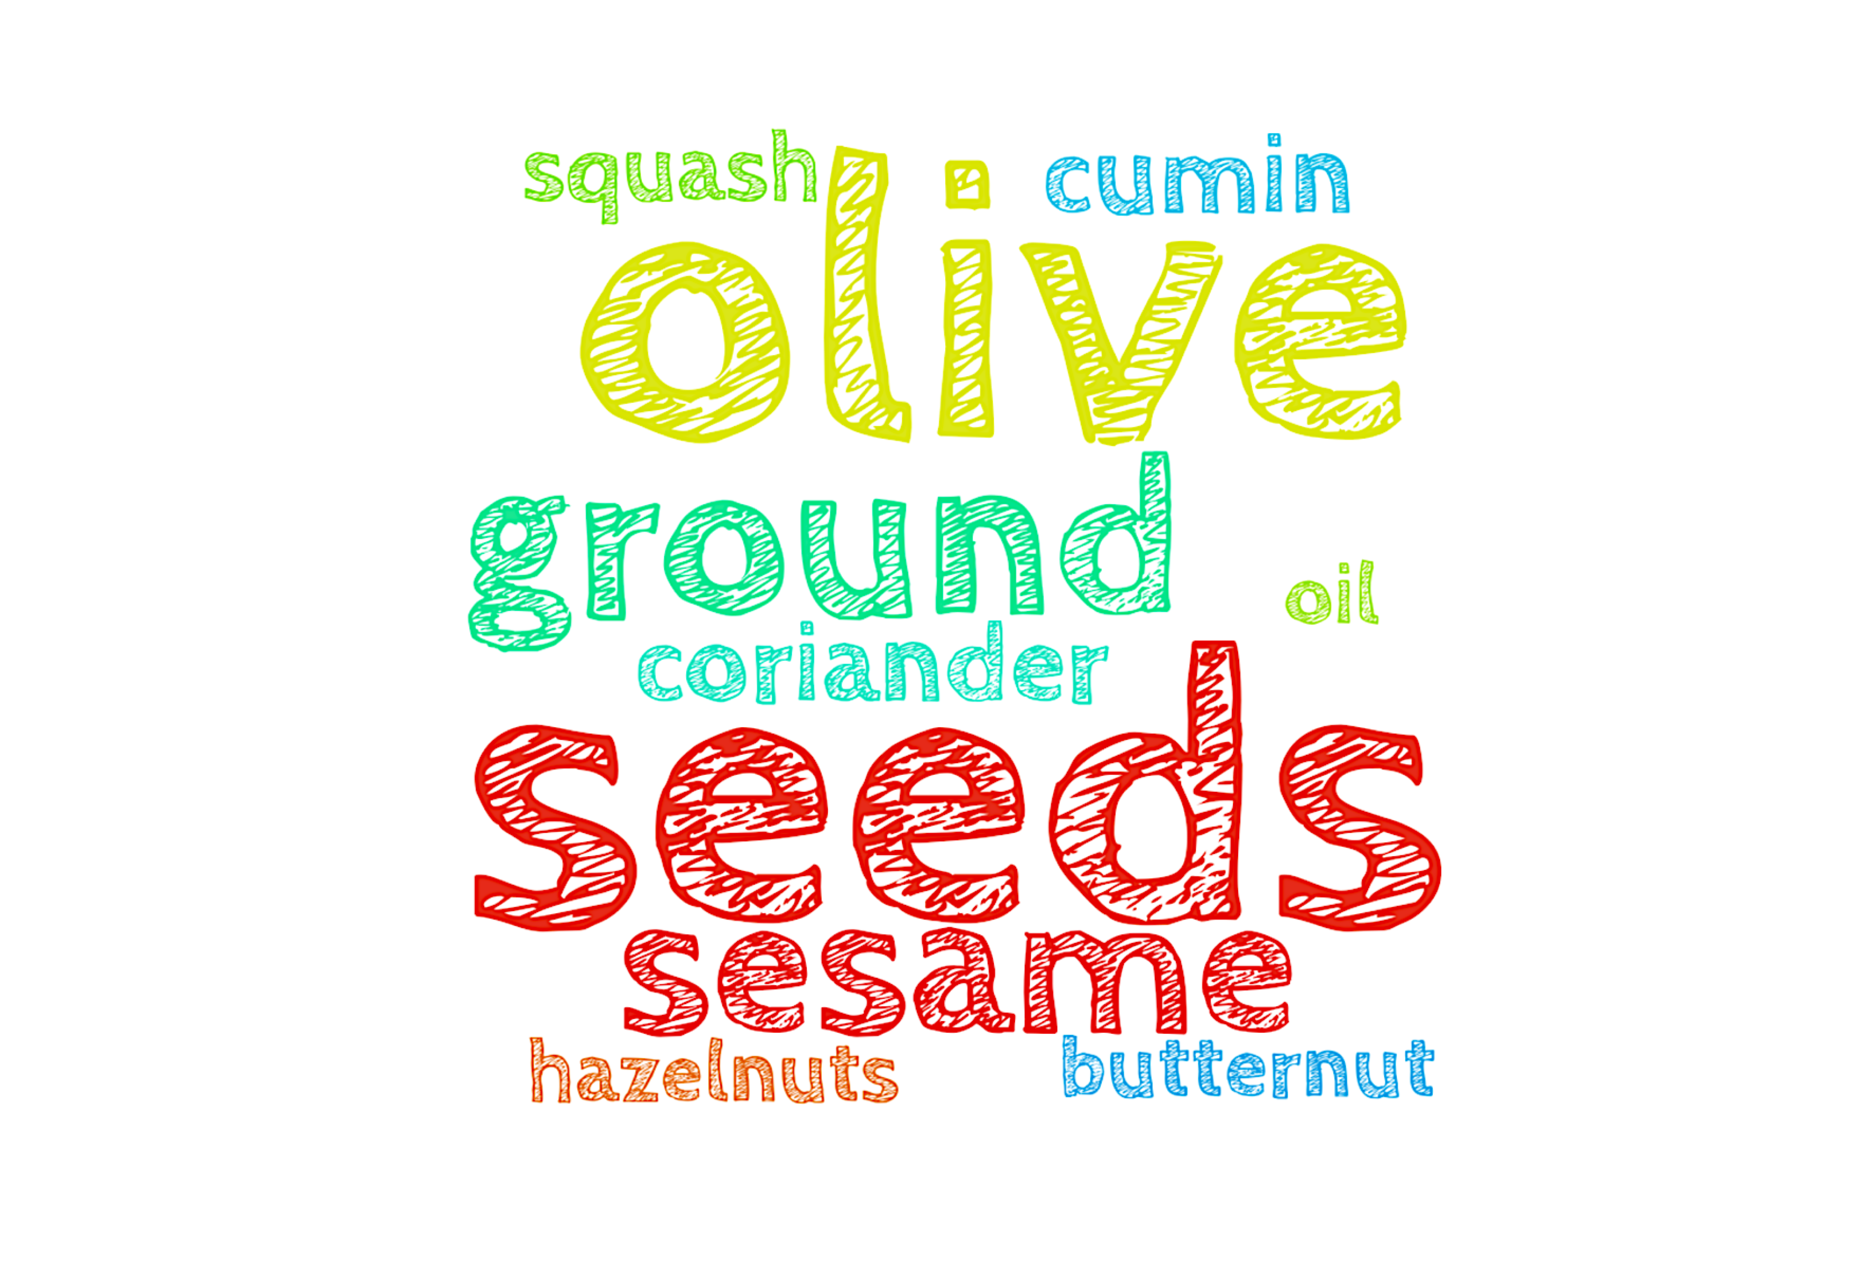
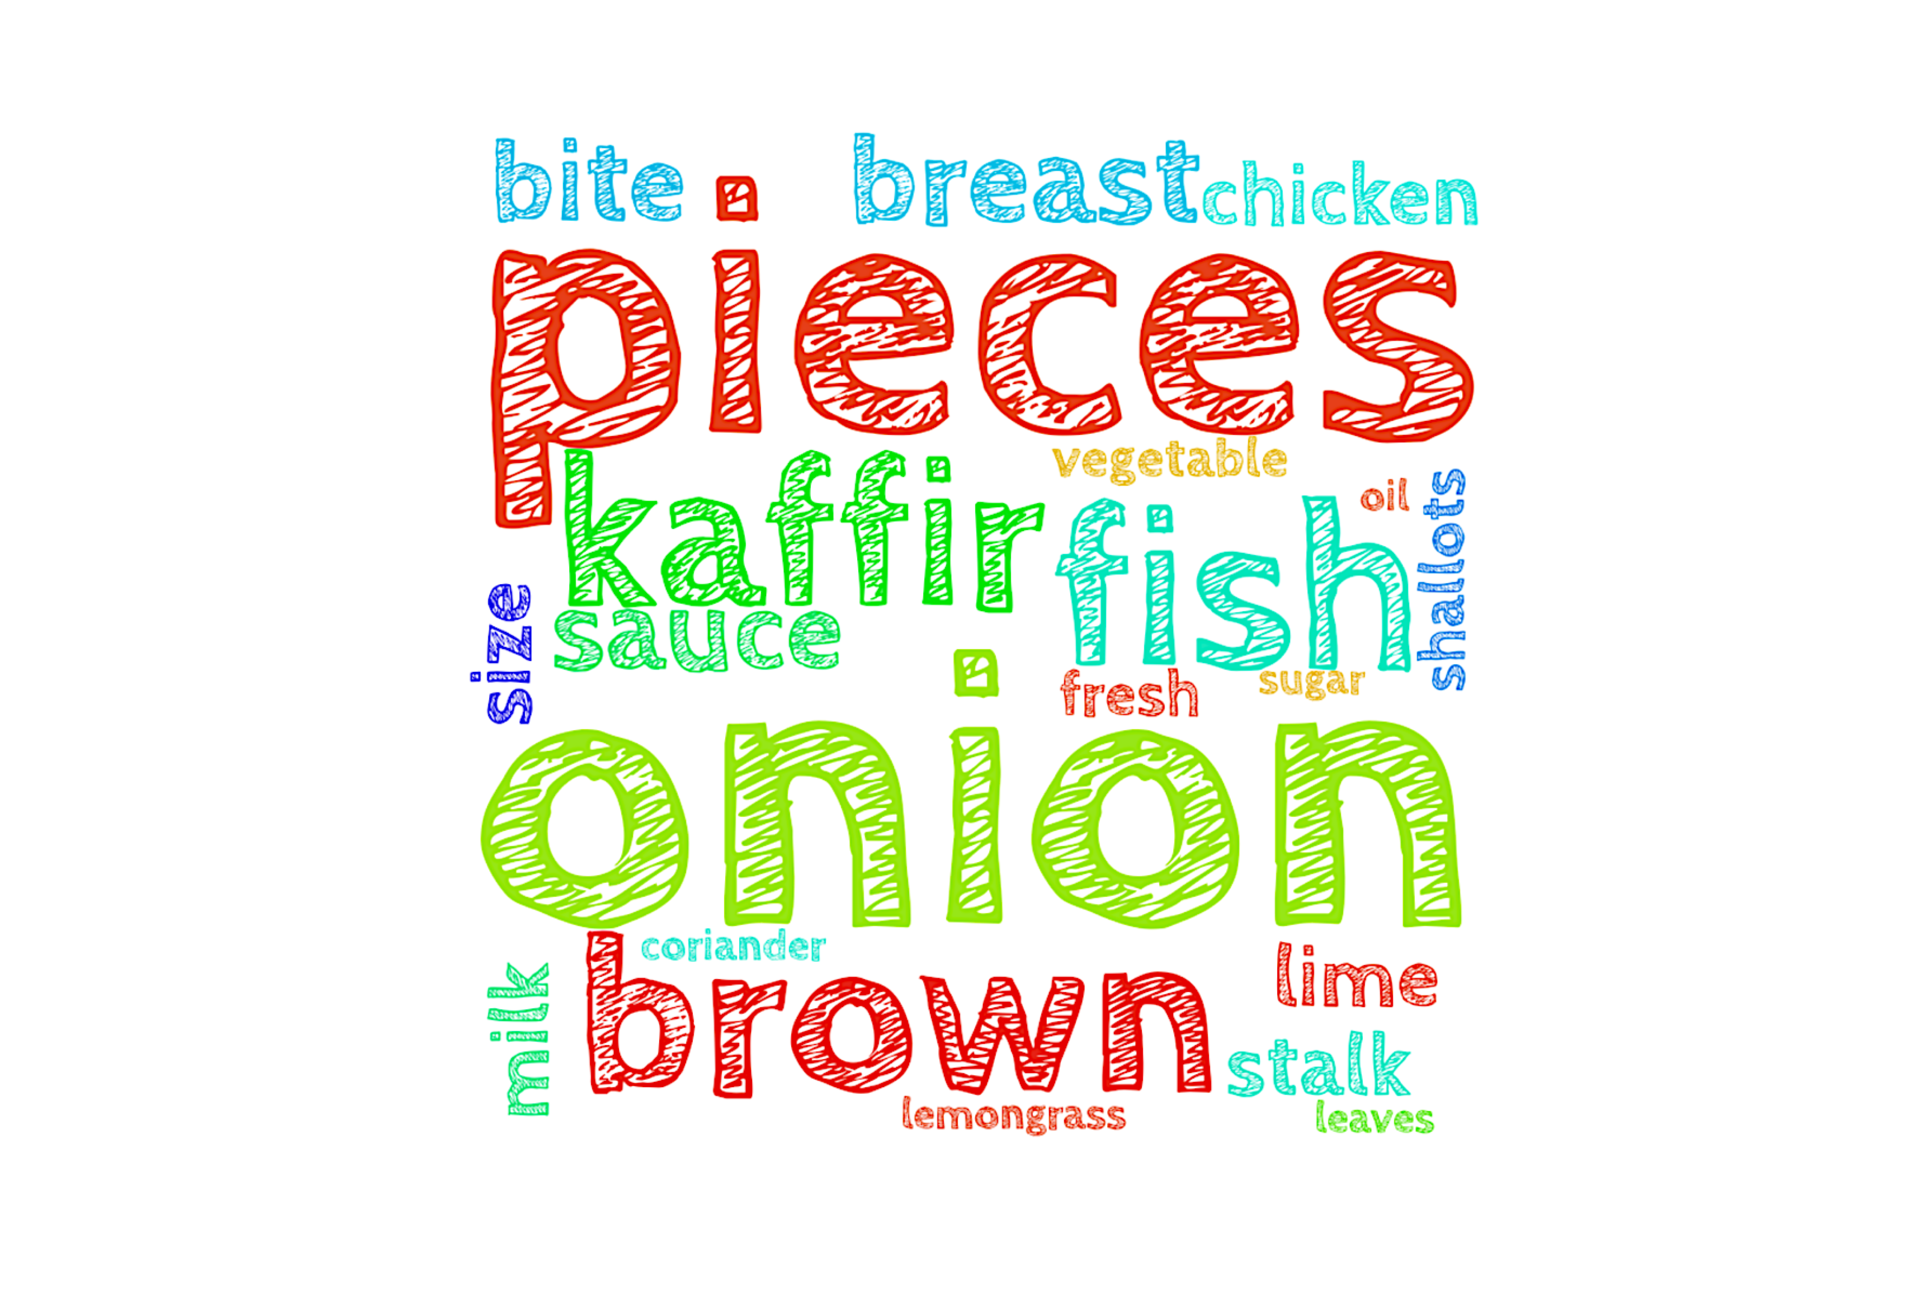
Ingredients + Recipe Titles…
Thai chicken curry
'shallots onion stalk lemongrass vegetable oil chicken breast bite-size pieces fish sauce sugar brown kaffir lime leaves milk fresh coriander’
[['Pineapple, beef & ginger stir-fry', 0.825],
['Easy peasy risotto with chilli & mint crumbs', 0.82],
['Corn cups with prawns, mango & chillies', 0.808],
['Spicy prawn soup', 0.803],
['Sweet potato & lentil soup', 0.799]]

Slide 8
Ingredients + Recipe Titles…
Dukkah-crusted squash wedges
'hazelnuts coriander seeds sesame seeds ground cumin butternut squash olive oil'
Out[1812]:
[['Samosa pie', 0.882],
['Butter bean & tomato salad', 0.878],
['Fully loaded Cajun chicken burgers', 0.873],
['Lamb kofta stew with cauliflower & chickpeas', 0.862],
['Grilled flaky naans', 0.861]]

Slide 9
Ingredients + Recipe Titles…
Slow-roasted rhubarb with ginger ice cream
'best-quality rhubarb dessert wine caster sugar oranges zest strips stem ginger syrup full-fat milk egg yolks caster sugar double cream shortbread'
[['Sloe gin', 0.917],
['Baked apples with prunes, cinnamon & ginger', 0.901],
['Floating islands with caramel sauce', 0.9],
["Chilled strawberry & Pimm's zabaglione", 0.9],
['Roast sirloin of beef & Port gravy', 0.899]]

Slide 10
Ingredients + Recipe Titles…
​Ultimate chocolate cake
dark chocolate cocoa solids butter instant coffee granules self-raising flour flour soda bicarbonate-soda muscovado sugar golden caster sugar cocoa egg buttermilk chocolate curls dark chocolate double cream golden caster sugar'
[["Millionaire's chocolate tart", 0.936],
['Mini Mont Blancs', 0.933],
['Fudgy chocolate cake', 0.924],
['Freeze-ahead chocolate & chestnut parfait', 0.918],
['Double chocolate profiteroles with salted caramel cream', 0.912]]

Slide 11
WebApp – recipe suggestion based on ingredinet similarity

Slide 12
Summary:
Input bag-of-words determines the ‘quality’ | context of ‘associations’ – changes with ‘non-ingredient’ word list weeding update…
“Ingredient” tokens vs. non-ingredient tokens… MODELLING
Some sensible recipe suggestions ~ similarity of ingredients
Some creative recipe suggestions ~ ingredient descriptors

Slide 13

…. Just in case Recipe Suggestor based on similar ingredient tokens
H-R May Merkle-Tan, PhD
hengrumay@gmail.cm
https://github.com/hengrumay

